Slide 1


How natural phenomenas and world scales affect the wheat price in the United States
Nir Kedem Kfir Shabi

Slide 2


sources
שער מסחר החיטה בארה"ב
שער מסחר הנפט בארה"ב
wunderground
Our Data
Notes:
קישור לשער מסחר החיטה בארה"ב
קישור לשער מסחר הנפט בארה"ב
קישור ל: wunderground

Slide 3

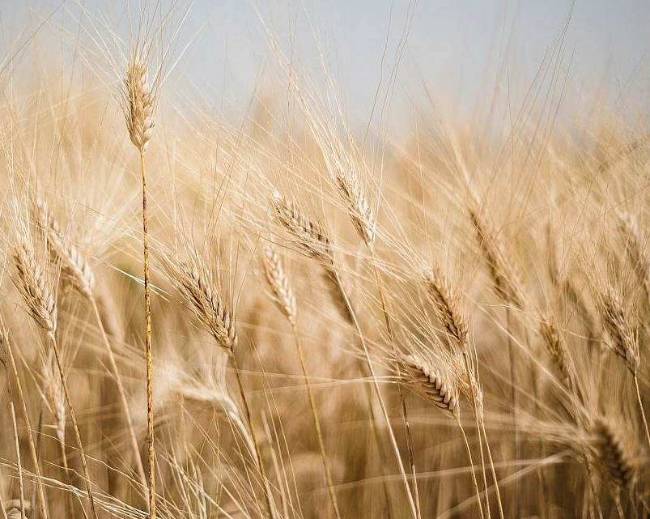
Why?
Kfir worked in a bakery a few semesters ago and suddenly the prices of bread went up.
Confused, he asked the manager as to why that is the case and ended up finding out that wheat prices went up.
Later the both of us discussed it and ended up thinking this is a good idea for a project: it has interesting real-world consequences and it doesn’t have a trivial answer

Slide 4
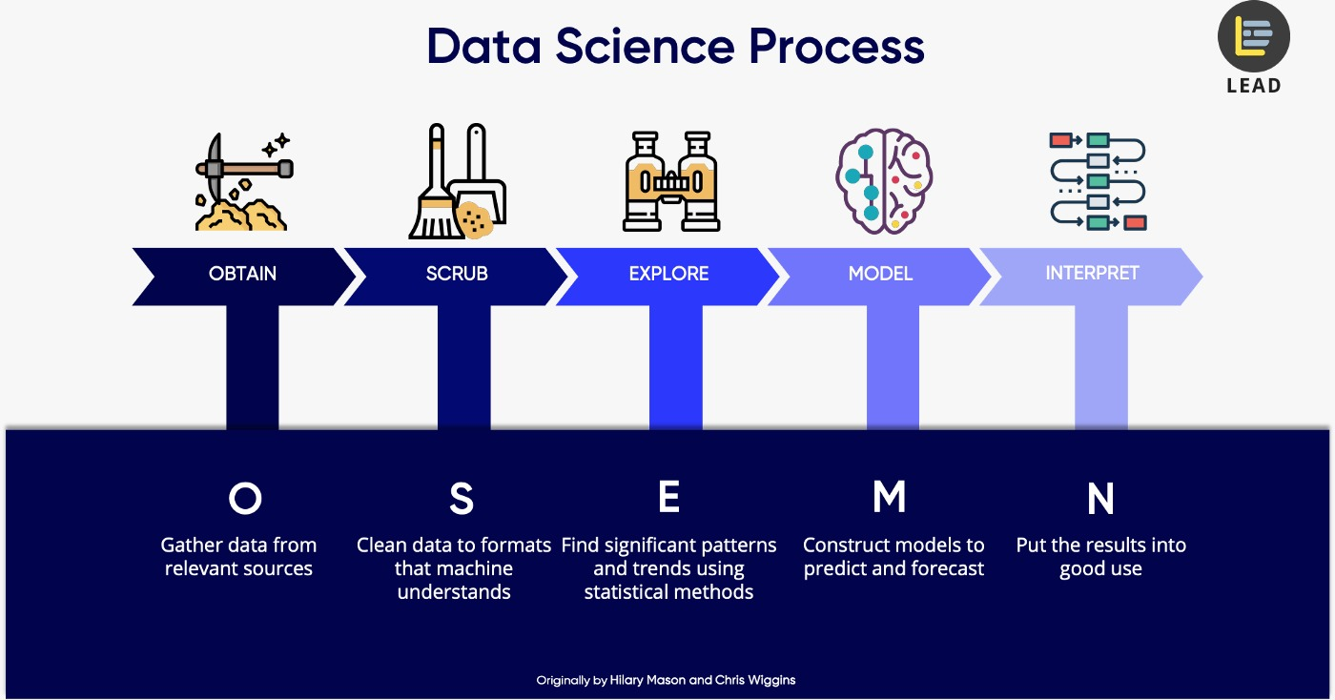

Slide 5

Crawling and Data Gathering

Slide 6
Crawling and Data Gathering
BeatifulSoup
Tried using but the page didn't load properly ☹
Selenium
Succeeded in getting to the data we were looking for! ☺
Getting the data
By going through the html contents of the page we got hold of the data

Slide 7
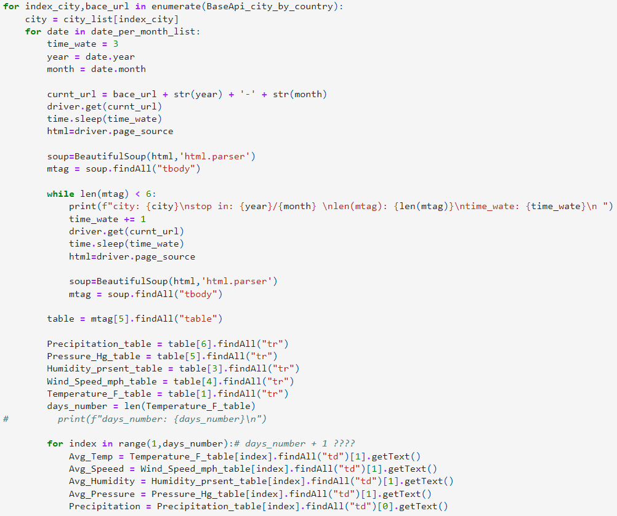
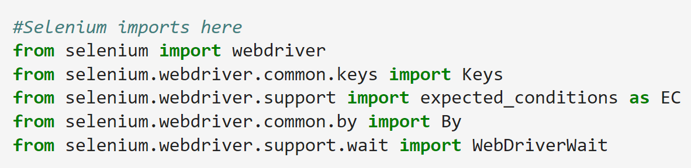

Crawling and Data Gathering – Our Code

Slide 8
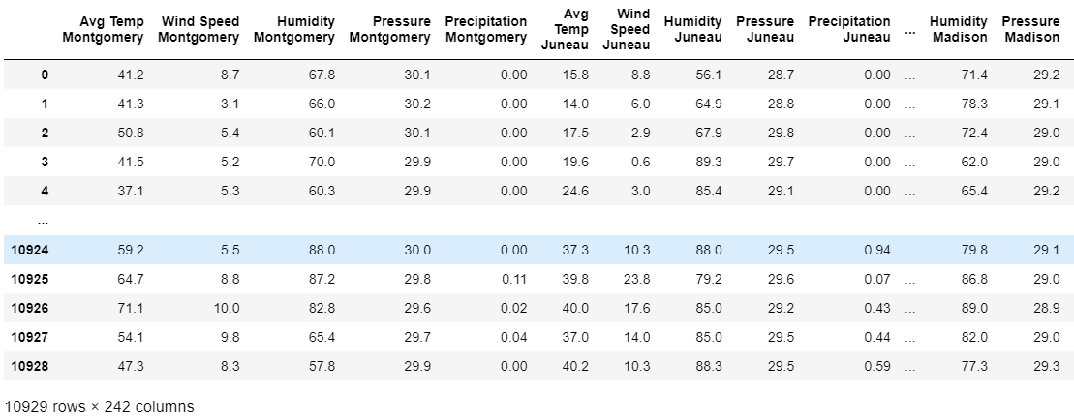
Our Data

Slide 9
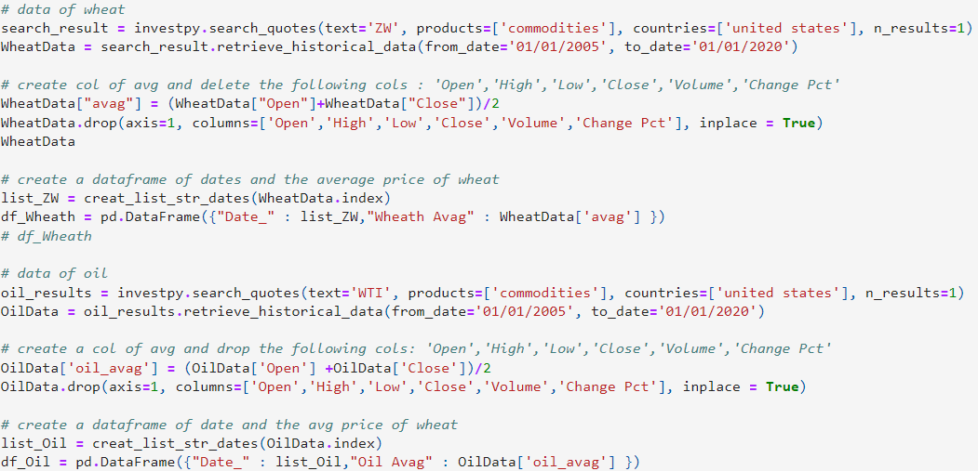
Investpy
gets wheat and oil pricing data from Investing.com

Slide 10
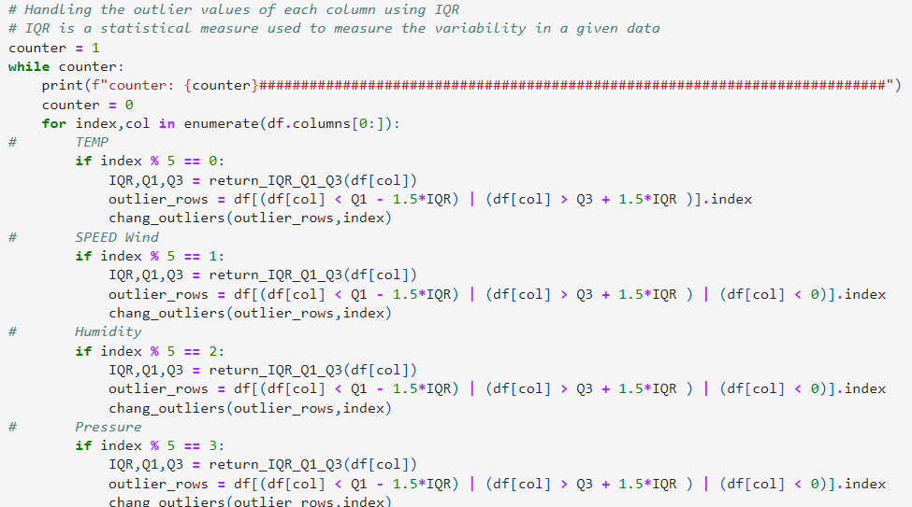
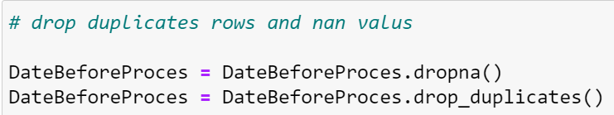
Data Cleaning
Dealing with missing values
Dealing with outliers

Slide 11
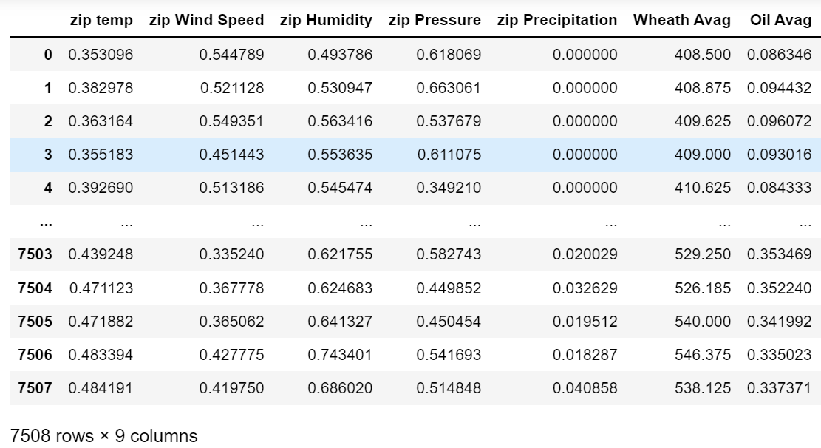
Data after Cleaning and merging
After cleaning, merging and normalized the data with oil prices and wheat prices we got 1,800,000 data points
1.8M DATA POINTS

Slide 12
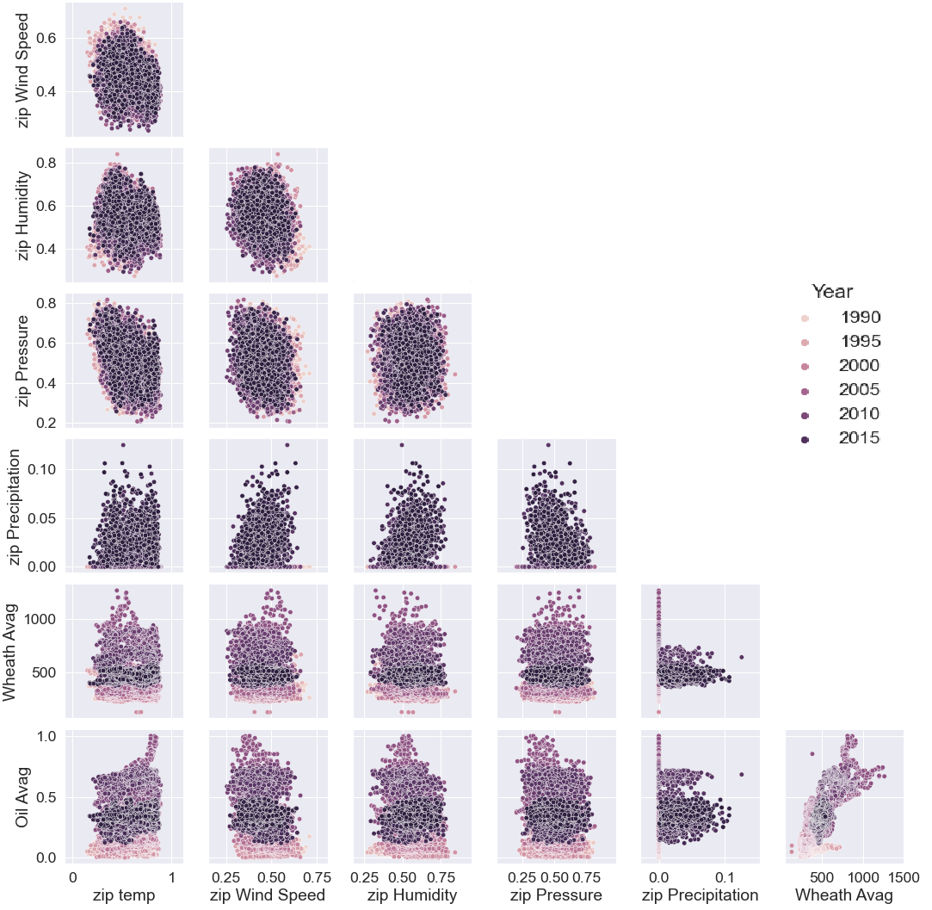
EDA- visualization
We were looking for correlations in the dataset
Noticed a correlation between wheat and oil prices

Slide 13
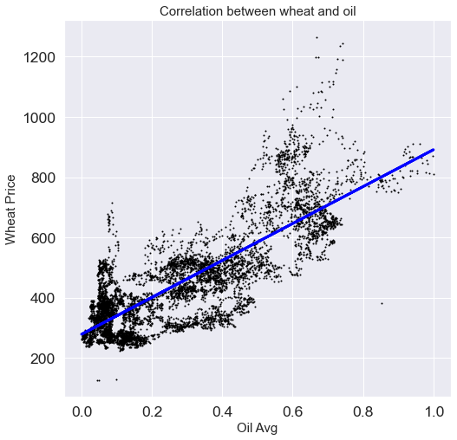
EDA- visualization
Decided to do a linear regression
Check how strong the correlation between these two attributes is
But we found the accuracy rate of the model disappointing

Slide 14
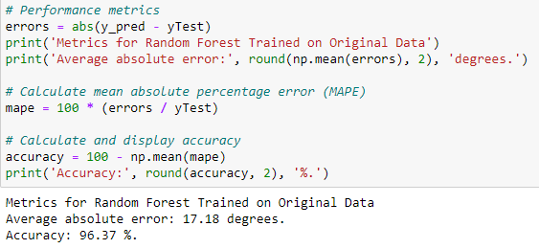
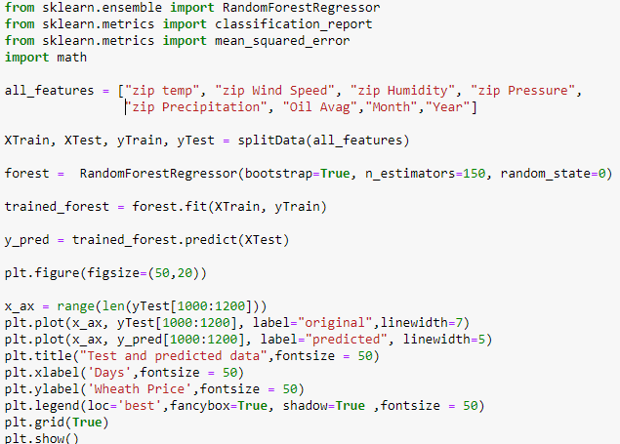
Random Forest Regressor
Notes:
By using sklearn we decided to apply RandomForestRegressor which helps us to train a model that predict average price of wheat

Slide 15
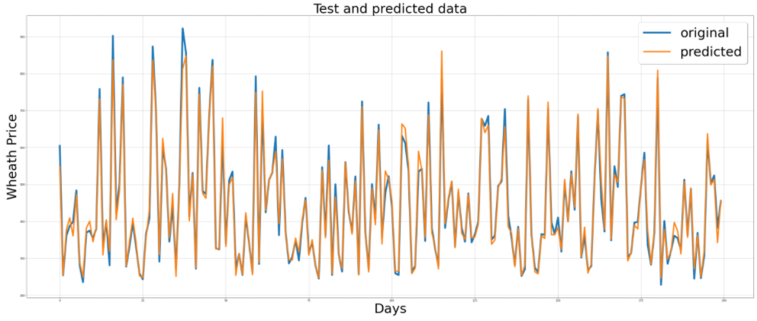
Accuracy
We saw that the accuracy rate for the RandomForestRegressor model is better
Original values vs. predicted values in one plot showing how accurate the model is

Slide 16
Conclusions
After using RandomForest
we conclude that there is a positive correlation between the price of wheat, price of oil and weather data in the US
This is not a correlation that we can express clearly, but the machine learning process can spot it
this clearly shows how great the data science field and machine learning field are

